Slide 1
Sprint 8 Demo
Tuesday, August 9th , 2022

Slide 2
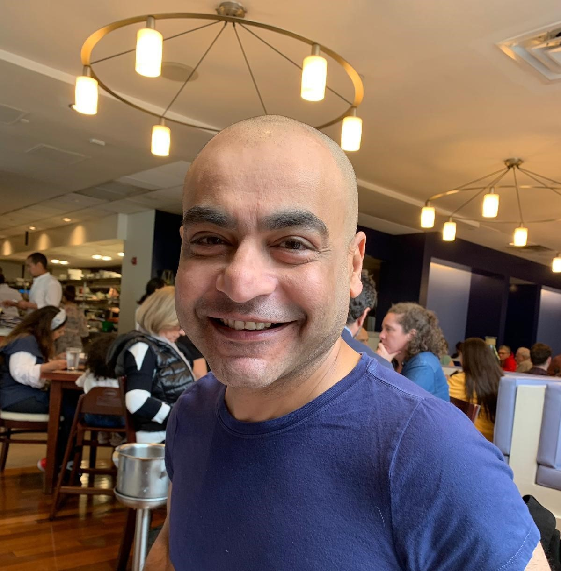
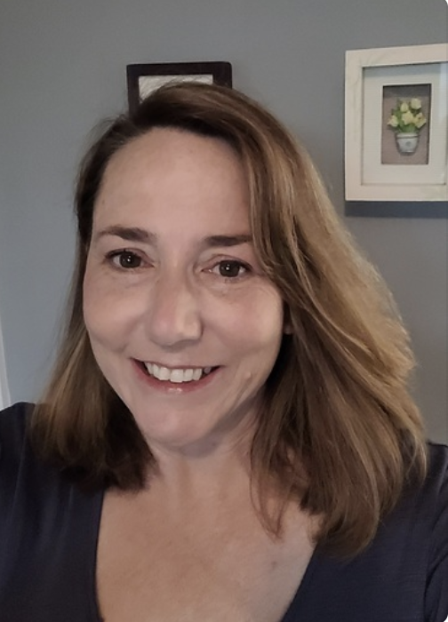

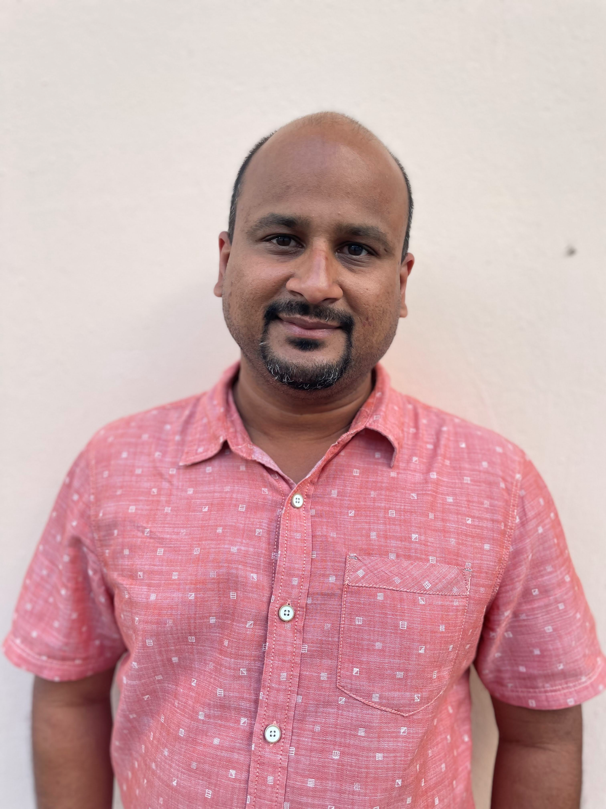










Get to know the team
Core team
Executive team
PRODUCT
ENGINEERING
Munish Sikka
Washington DC
Product Lead
Tami Corson
North Carolina
Clinical SME / Scrum
Dan Smith
Charleston, SC
QA Engineer / 508 Specialist
Shashank Khandelwal
Rockville, MD
Tech Lead
Jeff Scheire
MO Studio
Marcy Jacobs
McKinsey & Co
Kevin London Frog Design
DESIGN
Teagan Stephenson
Ft. Lauderdale, FL
Full Stack Engineer
1095-B Product Only
Thomas McCue Oak Park, IL Principal Designer Director
Carl Dickerson Atlanta, GA Content Strategist and Plain Language Content Creator
Carolyn Williams Chicago, IL Experience Designer
Will Reynolds SERVE Advisory
Ben Morris
Pluribus Digital
Jeanette Cantrell
MO Studio
08-09 Sprint 8 Demo
Introduction

Slide 3



At the end of each sprint on Tuesdays, the team will run sprint reviews to showcase the sprint’s work for approval. The purpose of this meeting is:
WELCOME TO THE SPRINT 8 DEMO
1
To demo the accomplishments or functionality that was built over the past sprint
2
To get feedback and insights early and often
3
To create transparency for anyone interested on the product and progress
08-09 Sprint 8 Demo
Introduction

Slide 4
CEDAR TO1 Overview
WE ARE HERE
CY 2021
CY 2022
PHASE
SPRINT
0
1
2
3
4
5
6
7
8
9
10
11
12
13
14
15
16
17
18
19
20
21
22
23
24
25
MONTH
Sep
Oct
Nov
Dec
Jan
Feb
Mar
Apr
May
Jun
Jul
Aug
Sep
DHM - Health Apartment
FOCUS
1095-B Form
Opt-in
Community Care
Health Hub
08-09 Sprint 8 Demo
Introduction

Slide 5
Agenda
HEALTH HUB
Sprint Goal:
For sprint 8 we focused on finalizing research plan for moderated tree test for Health Hub, initiating final collaboration cycle tollgates for 1095-B, scheduling for staging review, and drafting post MVP plans.
Research plan #2
1095-B
Collaboration Cycle – Privacy & Security Review
Collaboration Cycle – Analytics Implementation & QA
Collaboration Cycle – Pre-staging accessibility checks
Pathway to MVP launch
POST-MVP OPT-IN AND TURNOVER PLAN
Closeout plan
Transition of ownership
 | We welcome all feedback! Feedback will be collectively reviewed and prioritized appropriately based on where it stacks against other stories in the backlog as well as technical feasibility.
08-09 Sprint 8 Demo
Agenda

Slide 6
Health Hub
SPRINT 8 DEMO
08-09 Sprint 8 Demo

Slide 7



Health Hub Workplan v8
Owned by product team
WE ARE HERE
SPRINT 1
4/20 – 5/03
SPRINT 2
5/04 – 5/17
SPRINT 3
5/18 – 5/31
SPRINT 4
6/01 – 6 /14
SPRINT 5
6/15 – 6/28
SPRINT 6
6/29 – 7/12
SPRINT 7
7/13 – 7/26
SPRINT 8
7/27 – 8/09
SPRINT 9
8/10 – 8/23
SPRINT 10
8/24 – 9/6
Kickoff
Discovery
Build Roadmap
Product & Delivery
Build initial workplan and backlog
Business partner discovery
Moderated IA treejack Research
Moderated IA treejack interviews & synthesis
User Experience & Design
Comparative research
Consolidate existing research
Experience Map
Current state mapping
Research Activities Plan (RAP)
IA Tree Test Plan H0 & H1
Final IA Recommendations delivered
Engineering & Development
Tech Discovery
08-09 Sprint 8 Demo
Workplan

Slide 8
A
Research phase 2: Moderated testing of IA trees
User Story: Align w/ VA-PO and business partners on scope and direction of research
User Story: Finalize research plan #2 – Moderated testing of trees
User Story: Finalize conversation guide #2 – Moderated testing of trees
User Story: Submit research plan and conversation guide #2
User Story: Upload trees for each hypothesis in Optimal Workshop
Research Plan & Conversation Guide
Submitted for approval
Next Steps
Meet with Perigean to discuss recruiting
Practice interviews with 2 pilot participants
Interviews with Veterans to begin August 15th
Research plan & conversation guide
08-09 Sprint 8 Demo
Health Hub
8

Slide 9
Research phase 2: Recruitment
User Story: Recruitment plan
Recruiting
Recruiting will focus on Veterans only
A total of 40 participants will be recruited to account for a goal of 20 with the potential for no-shows/cancellations
The total will be broken into four cohorts, two for each hypothesis, with 5-8 participants in each
Respectively for each hypothesis, one cohort will be Veterans enrolled in VA health care, one not enrolled in VA health care
Even distribution of enrolled and non-enrolled participants across both hypotheses
Continued emphasis on inclusivity for the total body of participants
Cohort | Hypothesis | Enrollment | # of participants
1 | H0 | n | 5-8
2 | H0 | y | 5-8
3 | H1 | n | 5-8
4 | H1 | y | 5-8
08-09 Sprint 8 Demo
Health Hub
9

Slide 10
1095-B
SPRINT 8 DEMO
08-09 Sprint 8 Demo

Slide 11

1095-B Workplan v8
Collab cycle tollgates
Release
WE ARE HERE
SPRINT 7
4/20 – 5/03
SPRINT 8
5/04 – 5/17
SPRINT 9
5/18 – 5/31
SPRINT 10
6/01 – 6/14
SPRINT 11
6/15 – 6/28
SPRINT 13
6/29 – 7/12
SPRINT 14
7/13 – 7/26
SPRINT 15
7/27 – 8/09
SPRINT 16
8/10 – 8/23
SPRINT 17
8/24 – 9/6
1095-B: Spanish translation docs
Turnover document of remaining post-MVP work (VA notify, 2022 IRS form, 508 compliance, multiple year selection)
1095-B: Legal Review
1095-B: Legal Review – Opt-in
Product & Delivery
VA 508 Assistance request
MVP 508 Spanish translation docs
Kickoff
Align on launch MVP v. MVP w/ opt-in
Design for opt-in
User Experience & Design
Notification flow
Design for MVP 508 accessibility
Build for accessible MVP
Engineering & Development
Plan for and facilitate post MVP opt-in
Build for Analytics
Collaboration Cycle
Sitewide and Content IA ticket opt-in
Call center review
Analytics & QA
MVP staging review
1095-B Post launch evaluation
Security &
privacy review
MVP launch
Go Live
08-09 Sprint 8 Demo
Workplan
11

Slide 12
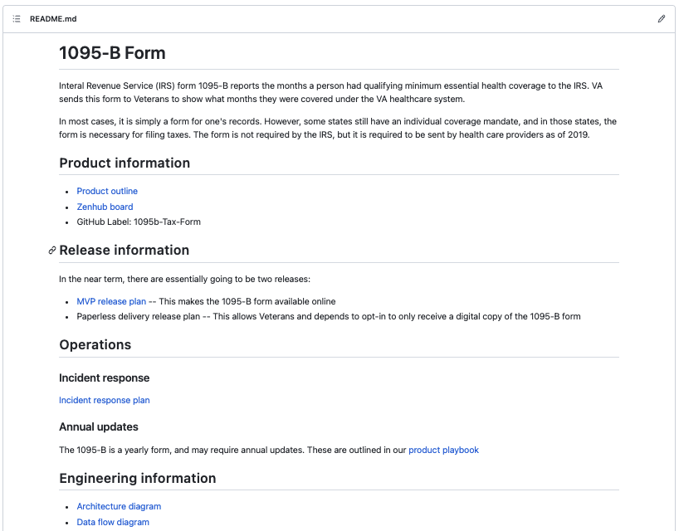
A
We prepared for privacy, security, and infrastructure readiness review
User Story: Privacy, security, & infrastructure review
Artifacts
Updated product README
Iterated on product outline
Created release plan
Architecture diagram
Sequencing diagram
Data flow diagram
Drafted incident response plan
README with links to artifacts
08-09 Sprint 8 Demo
1095-B
12

Slide 13
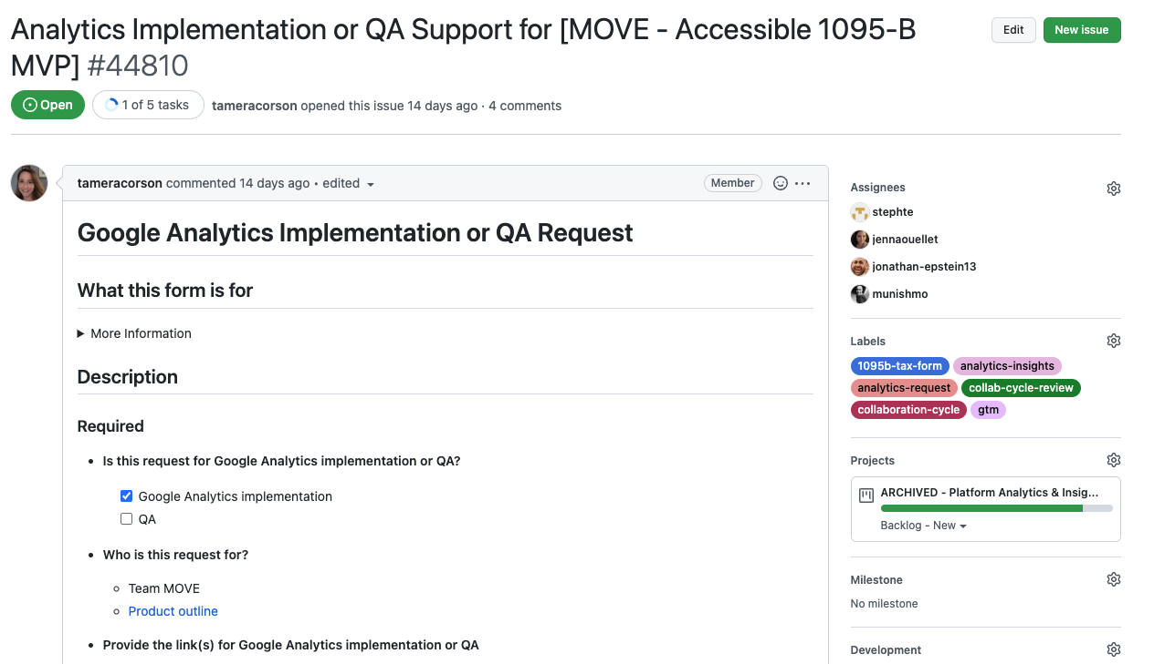
B
We prepared for Analytics Implementation
User Story: Analytics implementation and QA
Next steps
We’ll need to implement tracking for our (PDF, text) radio button. It’s one of the elements where tracking does not come out the box.
Met with Jenna Ouellet, will need to instrument radio buttons today.
Analytics support ticket
08-09 Sprint 8 Demo
1095-B
13

Slide 14
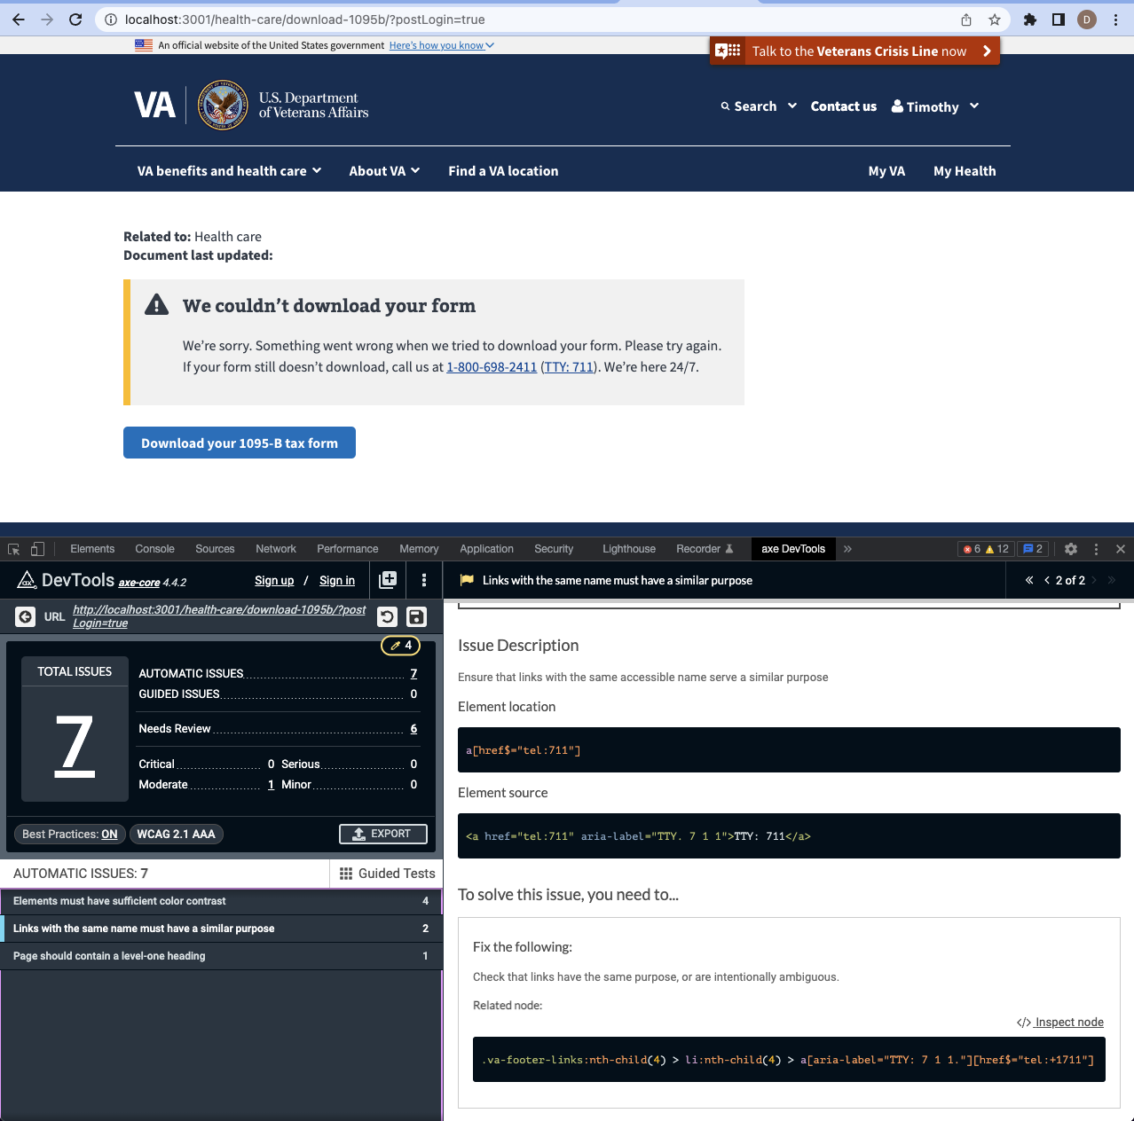
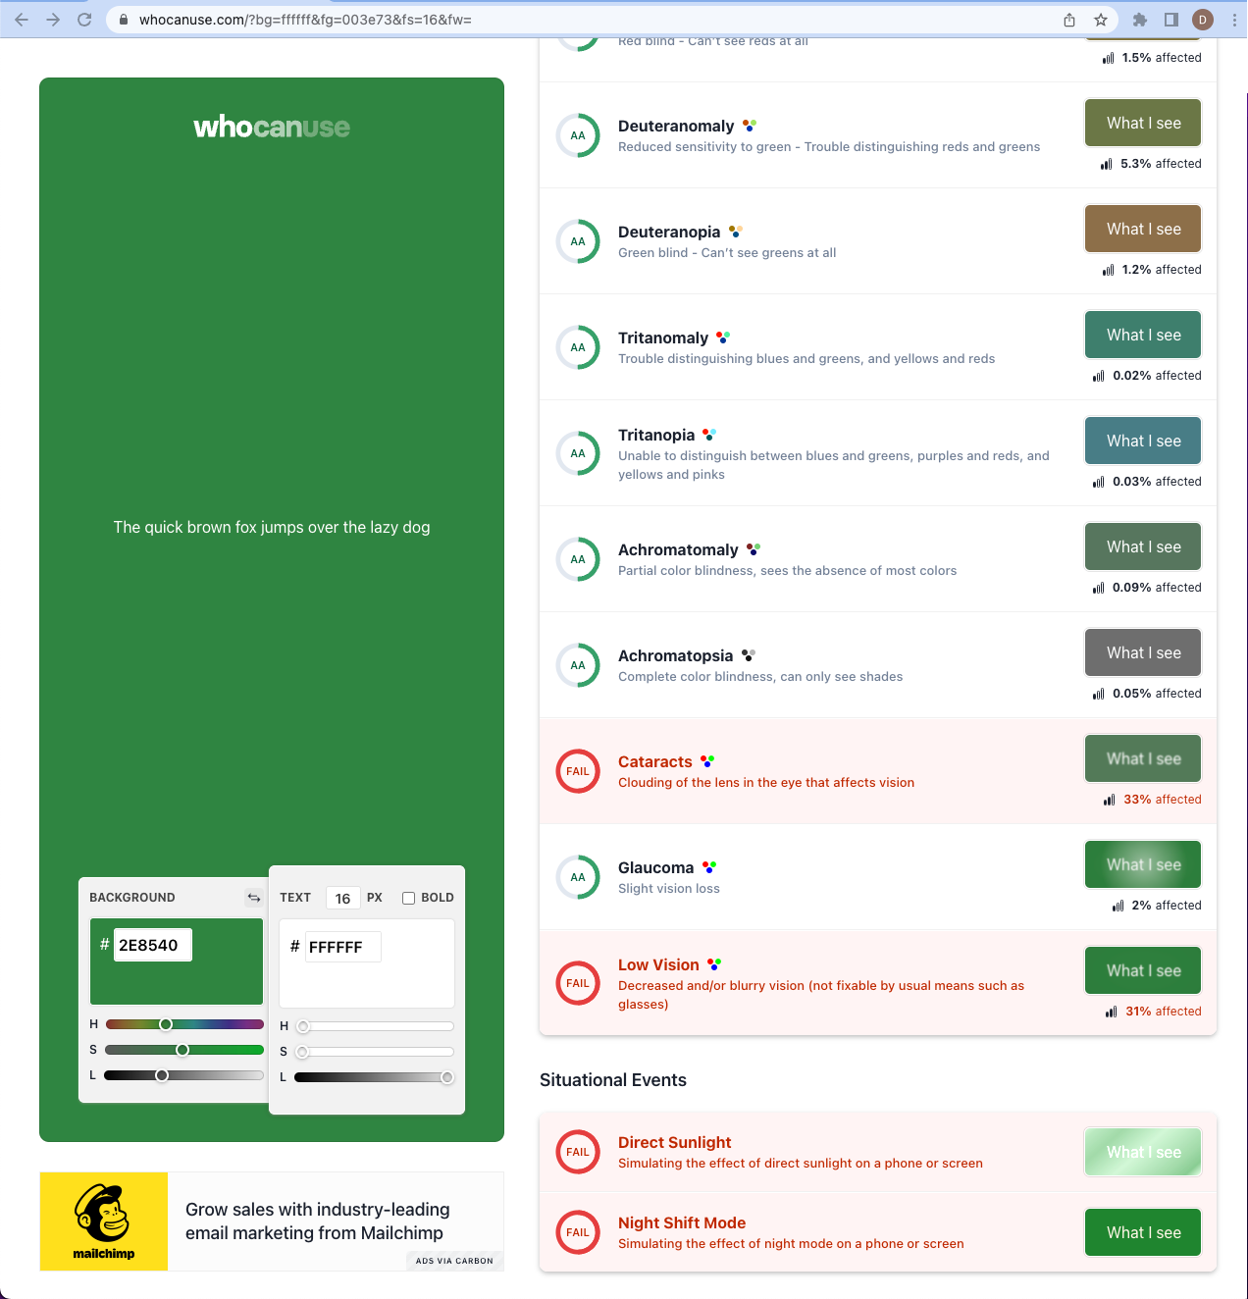
C
We prepared for and initiated pre-staging accessibility testing
User Story: Staging review accessibility checklist
Pre-staging tested (5 of 6)
Axe scan
- React widget
Color testing
- Reviewed w/ browser plugins – WCAG for AA rating
Content resizing
- Mac: – Chrome, Safari, Firefox (200%, 300%, 400%)
Keyboard function
- MacOS: Chrome, Safari, Firefox
Screen reader
- MacOS + Safari, Jaws
Built testing tools
Test Rails
Cypress
Remaining step (dark launch)
E2E Axe scan
Axe scan, ticket
08-09 Sprint 8 Demo
1095-B
14

Slide 15
Steps to 1095-B MVP launch (1 of 2)
Delayed
In progress
Completed
Not started
D
Step | OWNED BY | ACTION NEEDED | DATE ENTERED | STATUS | NOTES
Contact center review | 1095-B / Contact center | Artifacts to be quality reviewed by Contact center staff | 22-Jul-22 |  | Closed 8/9/22
Analytics implementation | 1095-B / Analytics | Ticket completion and alignment on KPIs | 27-Jul-22 |  | Jenna Ouellet provided guidance 8/9/22; Teagan adding to code / PR /merge
Privacy, security, and infrastructure review | 1095-B / Security | Ticket completion and all 9 artifacts attached | 27-Jul-22 |  | Submit Tues EOD
 |  | Product outline | 27-Jul-22 |  | Completed 8/4/22
 |  | Release plan | 27-Jul-22 |  | Completed 8/5/22
 |  | Incident response plan / Playbook | 27-Jul-22 |  | Completed 8/9/22; will iterate if feedback provided
 |  | Architecture diagram | 27-Jul-22 |  | Completed 8/9/22
 |  | Sequencing diagram | 27-Jul-22 |  | Completed 8/9/22
 |  | Data Flow diagram | 27-Jul-22 |  | Completed 8/8/22
 |  | API Endpoint document | 27-Jul-22 |  | Complete by Tues EOD
 |  | Accessibility file | 27-Jul-22 |  | 5 out of 6 test complete; Axe scan is done in dark launch
08-09 Sprint 8 Demo
1095-B

Slide 16
Steps to 1095-B MVP launch (2 of 2)
Delayed
In progress
Completed
Not started
Step | OWNED BY | ACTION NEEDED | DATE ENTERED | STATUS | NOTES
Resolve transport script / bucket | 1095-B / HEC | Reopen bucket ticket (GitHub #38079) and ensure Joshua (HEC) has access to appropriate buckets to fill transport script | 9-Aug-22 |  | Sprint 9
Staging review | 1095-B / Collab Cycle teams | Complete product ticket with documented previous collab cycle steps initiated and under async review. Platform notified of status 4 business days prior to meeting in order to review all artifacts and post recommendations. Meeting to be held 18 August 2022 @ 2PM. | 13-Jul -22 |  | Sprint 9
Dark launch | 1095-B | Dark launch 8/22-8/24/22 to complete final accessibility checks in production environment and guerilla UAT testing of product function using feature toggle. Record findings in release plan and staging accessibility ticket | 3-Aug-22 |  | Sprint 9 /10
Research plan - Moderated UAT | 1095-B / Perigean / VA Research | Create research plan, and conversation guide for moderated UAT for approval of VA research team and submission to Perigean for recruitment. | 5-Aug-22 |  | Sprint 9
Moderated UAT | 1095-B | Moderated usability testing with Veteran’s recruited through Perigean. 8/25-8/26/22. Record findings in product release plan | 5-Aug-22 |  | Sprint 10
Staged Rollout | 1095-B | Roll out of product on VA.gov will be staged and include feature toggle. Canary test 25% 8/26-8/30/22 ; Stage B 50% 8/30-9/5/22. Incident response plan will be followed if product fails to perform as desired. | 5-Aug-22 |  | Sprint 10
Go Live | 1095-B | Official go-live target 9/5/2022 | 7-Aug-22 |  | Sprint 10
08-09 Sprint 8 Demo
1095-B

Slide 17
Path to Task Order close-out
SPRINT 8 DEMO
08-09 Sprint 9 Demo

Slide 18
CEDAR TO1 closeout (1 of 3) v1
Delayed
In progress
Completed
Not started
Step | OWNED BY / TURNOVER TO | ACTION NEEDED | COMPLETED | STATUS | NOTES
Completion of HH research #1 w/ caregivers | HealthHub / Mikki | Amend research plan to initiate final unmoderated testing of remaining caregivers | 9-Aug-22
 |  | Submit research plan for recruitment by Perigean | 9-Aug-22
 |  | Put research plan, guide, data sets, and synthesis in GitHub HH repo turnover folder, marked research #1. |  |  | Sprint 9
Completion of HH research #2 – Moderated tree test | HealthHub / Mikki | Submit research #2 to Mikki for feedback and approval | 8-Aug-22
 |  | Submit research #2 to oCTO for approval and recruitment (Must request Perigean note taker service) | 9-Aug-22
 |  | Conduct pilot testing |  |  | Sprint 9
 |  | Conduct moderated testing of trees |  |  | Sprint 9
 |  | Synthesis research findings and make recommendation if able |  |  | Sprint 10
 |  | Put research plan, guide, data sets, Perigean notes, synthesis, recommendations (if able) in GitHub HH repo turnover folder, marked research #2 |  |  | Sprint 10
HH Turnover document | HealthHub / Mikki & Tracey | Turnover document (include links to discovery, all research documents, and recommended next steps. Place in GitHub HealthHub repo turnover folder. Send link to Mikki Northius & Tracey Mulrooney for review / edits |  |  | Draft sprint 9, due sprint 10
08-09 Sprint 8 Demo
TO1 Closeout

Slide 19
CEDAR TO1 closeout (2 of 3)
Delayed
In progress
Completed
Not started
Step | OWNED BY / TURNOVER TO | ACTION NEEDED | COMPLETED | STATUS | NOTES
Analytics | 1095-B | Implement analytics in pre-staging and provide implementation monitoring status / turnover |  |  | Initiated sprint 8
Dark Launch, usability test 1095-B MVP | 1095-B | Dark launch 9/22-8/24/22. Usability testing with coworkers and other VFS teams IAW release plan |  |  | Sprint 9
 |  | Document findings of Guerrilla usability testing in release plan |  |  | Sprint 10
Research plan - Moderated UAT | 1095-B | Create research plan, and conversation guide for moderated UAT for approval of VA research team and submission to Perigean for recruitment. Record findings in release plan and staging accessibility ticket |  |  | Sprint 9
Moderated UAT | 1095-B | Complete moderated UAT 8/25-8/26/22 and document in assessment in product release plan |  |  | Sprint 10
Staged rollout | 1095-B | Roll out of product on VA.gov will be staged and include feature toggle. Canary test 25% 8/26-8/30/22 ; Stage B 50% 8/30-9/5/22. Incident response plan will be followed if product fails to perform as desired. |  |  | Sprint 10
HEC Spanish translated documents | 1095-B | Monitor status of 1095-B translation of HEC documents from State Department via Sitewide (Randi Hecht) and turn over to business owner (Tarsha Tremble) |  |  | Submitted for translation (opt-in) 8/2/2022
1095-B Turnover document (MVP and Opt-in) | 1095-B / Tracey & Health Apps team | Turnover document (include links to discovery, research documents, collaboration cycle product documents, Opt-in build plan, and recommended next steps with owners timelines. Place in GitHub 1095-B repo turnover folder. Send link to Tracey Mulrooney for review / edits. |  |  | Draft sprint 9, due sprint 10
TO1 Closeout

Slide 20
CEDAR TO1 closeout (3 of 3)
Delayed
In progress
Completed
Not started
Step | OWNED BY / TURNOVER TO | ACTION NEEDED | COMPLETED | STATUS | NOTES
HEC requirements ticket | 1095-B / HEC | Provide requirements for Tarsha (HEC) to submit ticket |  |  | Sprint 9
HEC written approval | HEC / 1095-B | Obtain and upload into product repo written approval of MVP design and content prior to launch (Due 21-Aug-22 to avoid shifting timeline) |  |  | Sprint 9/10 [Launch blocking dependency]
Turnover meeting | 1095-B / Health Apps | Tracey will arrange a 30 minute meeting with Health Apps team to review product in Sprint 9 and a 60 minute meeting to review turnover document and plan for next steps. Additionally, team will be available for asynchronous questions after initial meeting. |  |  | Sprint 9 & 10
TO1 Closeout

Slide 21
New 1095-B team, next steps (1 of 2) v1
Delayed
In progress
Completed
Not started
Step | OWNED BY | ACTION NEEDED | COMPLETED | STATUS | NOTES
Post launch review (1week) | Health Apps | Complete post launch assessment in product release plan. Due 12-Sep-22
Post launch review (1 month) | Health Apps | Complete post launch assessment in product release plan. Due 5-Oct-22
HEC documents - Spanish translation | Health Apps | Monitor status of 1095-B translation of HEC documents from State Department via Sitewide (Randi Hecht) and turn over to business owner (Tarsha Tremble) |  |  | Submitted for translation with opt-in 8/2/2022
Opt-in legal review | Health Apps MyVA OGC | Put together a legal package (product outline w/ opt-in, static page opt-in designs / content, MyVA opt-in designs / content) for review by OGC. Coordinated through HEC (Tarsha). |  |  | [Opt-in launch blocking dependency] Raun, Eric L. (OGC) <Eric.Raun@va.gov> Case# GCL 158655 Lawyer POC who reviewed MVP OGCHealthCareLawGroupAttorneys@va.gov General legal assistance email request line
Wayfinding | Health Apps Sitewide | Submit intake ticket with sitewide with IA document, user path, and crosslinks to wayfinding to create wayfinding to 1095-B page.
Monitor Opt-in profile build | MyVA VA Profile HEC BE | Monitor teams designing and building Veteran profiles to allow for opt-in / opt-out of digital delivery of 1095-B. POC: Samara Strauss- MyVA, Mike Richard- VA Profile BE, Joshua Faulkner- HEC BE. |  |  | Will split row based on owner and assigned work in next iteration of “next steps” artifacts
Monitor Opt-in notification build | MyVA VA Notify | Monitor notification for opt-in / opt-out of paperless delivery build. Draft notifications here. |  |  | Will split row based on owner and assigned work in next iteration of “next steps” artifacts
Link 1095-B page to Veterans profile | Health Apps Sitewide MyVA | Submit intake ticket with sitewide to build onto 1095-B Drupal page the opt-in design element (alert link) since opt-in element is the same in unauth and auth environment. opt-in designs
08-09 Sprint 8 Demo
New team

Slide 22
New 1095-B team, next Steps (2 of 2)
Delayed
In progress
Completed
Not started
Step | OWNED BY | ACTION NEEDED | COMPLETED | STATUS | NOTES
Communications plan | Health Apps | Build a communications plan for opt-in to advertise service, tax season notification for those who have opt-in. Sample veteran communication used by eBenefits
Multi-year build | Health Apps | Tax forms are commonly available for multiple years due to audits and delayed filing, offering a multi-year retrieval service could be a future enhancement
Removal of feature toggle code | Health Apps | Submit ticket to remove code for feature toggle on react widget after opt-in is built and functioning for 1 entire tax season
Timing for opt-in collaboration to be determined after 8/9/22 mtg; document will be updated at that time
08-09 Sprint 8 Demo
New team

Slide 23
Sprint Deliverables
SPRINT 8 DEMO
08-09 Sprint 8 Demo

Slide 24
Sprint 8 Deliverables (1 of 2)
EPIC | STORY | ESTIMATE | ASSIGNED | OUTPUT | REVIEWED W/ VA-PO | SPRINT TEAM GOAL COMPLETED?
Staging | #44814 Release Plan | 8 | 8 | Release Plan | 8/9/2022 | ✓
Collab | #44811 Staging review accessibility checklist | 8 | Dan | Ticket | 8/9/2022 | ✓
Staging | #44401 Collaboration cycle: MOVE, 1095-B, Accessible version of product in staging | 1 | Tami Munish | Ticket | 8/9/2022 | ✓
Collab | #45593 Collaboration Cycle: Contact center review | 1 | Carl Tami | Product guide (edited) Ticket | 8/9/2022 | ✓
Collab | #44812 Collaboration cycle: Privacy and security review | 5 | Shashank Munish | Incident response plan Architecture diagram Data flow diagram Sequencing diagram | 8/9/2022 | ✓
Collab | #44810 Collaboration cycle: Analytics implementation and QA | 3 | Munish Shashank Teagan | Ticket | 8/9/2022 | ✓
Opt-in | #42158 PM to follow up with VA-PO on Spanish translation of HEC documents | 0 | Tami | Ticket | 8/9/2022 | ✓
Tech | #45003 Platform orientation [Dan Smith] | 5 | Dan | Ticket | 8/9/2022 | ✓
PMO | #45119 Platform Orientation [Jeanette Cantrell] | 5 | Jeanette | Ticket | 8/9/2022 | ✓
1095-B | #45285 Build feature throttle for widget | 3 | Teagan | Ticket G#21847 | 8/9/2022 | ✓
08-09 Sprint 8 Demo
Sprint 8 Deliverables

Slide 25
Sprint 8 Deliverables (2 of 2)
EPIC | STORY | ESTIMATE | ASSIGNED | OUTPUT | REVIEWED W/ VA-PO | SPRINT TEAM GOAL COMPLETED?
Research | #44995 Align with VA-PO and Business partners on scope and direction of research | 1 | Carolyn Shashank Munish | NR | 7/27/2022 | ✓
Research | #44323 Finalize research plan #2 – moderated testing of trees | 1 | Carolyn | Research plan #2 | 8/9/2022 | ✓
Research | #44324 Finalize conversation guide #2 – moderated testing of trees Lorem | 1 | Carl | Conversation guide #2 | 8/9/2022 | ✓
Research | #44962 Recruitment plan | 1 | Thomas | Research plan #2 | 8/4/2022 | ✓
Research | #44720 Submit research plan and conversation guide #2 | 3 | Carolyn Carl | Research plan #2 Conversation guide #2 | 8/4/2022 | ✓
Research | #44960 Upload IA tree test into Optimal Workshop | 2 | Carolyn | NR | 8/4/2022 | ✓
Research | #45311 Resubmit Optimal workshop / research plan / conversation guide #1 to allow further unmoderated testing of caregivers for VA- IA | 2 | Carolyn | NR | 8/9/2022 | ✓
Opt-in | #44293 Align on opt-in build w/ VA Profile and Notify teams | 1 | Munish | 1095-B Opt-in build guide | 7/29/2022 | ✓
1095-B | #44997 Present 1095-B updates to Tarsha (HEC) | 3 | Munish Carl Tami | Business owner brief MVP Designs Opt-in Designs 1095-B engineering doc Business owner brief notes | 7/31/2022 | ✓
08-09 Sprint 8 Demo
Sprint 8 Deliverables

Slide 26
Preview of Sprint 9
SPRINT 8 DEMO
08-09 Sprint 9 Demo

Slide 27
Sprint 9 will focus on
 | Next sprint demo: Aug 23th
HEALTH HUB
*Stories subject to change during sprint planning
Status update on moderated research
Draft product turnover guide
1095-B
Staging review
Initial UAT
Moderated UAT research plan
Draft product turnover guide
08-09 Sprint 8 Demo
Preview of Sprint 9

Slide 28
Appendix
SPRINT 8 DEMO
08-09 Sprint 8 Demo

Slide 29
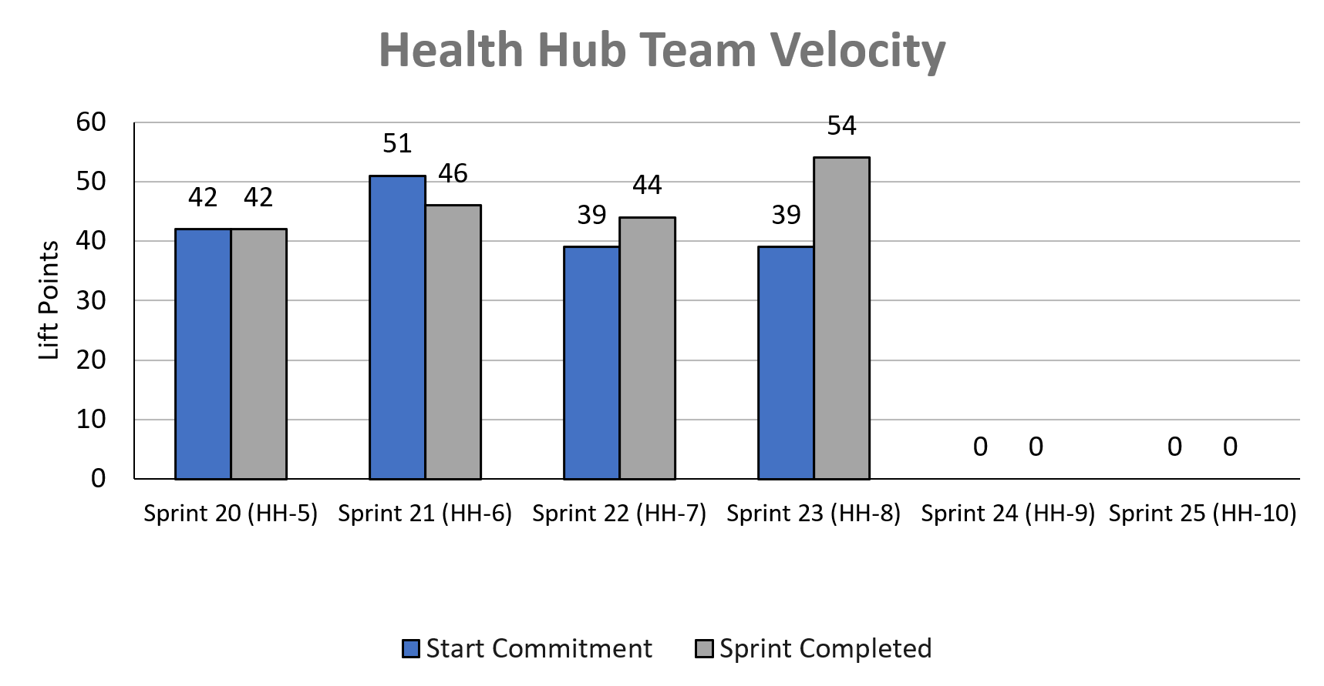
Health Hub Team velocity
 | Velocity details Velocity estimated in story points, using Fibonacci Velocity in Sprint 8 accounted for 8 team members 54 total story points were completed; Team committed to 39 story points at beginning of the sprint. 4 Stories added (14 points) to account for 2 added team member VA Platform onboarding (10), building of feature throttle (3), and reactivating Health Hub research plan #1 (2).
08-09 Sprint 8 Demo
Appendix
29

Slide 30
Project risks and mitigation strategies (1 of 2)
RISK AND IMPACT | MITIGATION STRATEGY | DATE |  | STATUS | NOTES
 |  | ENTERED | CLOSED
IRS stakeholder is outside of VA ecosystem. Building without guidance or legal review regarding compliance with IRS regulation could result in risk. | Conduct research on available information surrounding current IRS 1095-B tax form regulations. Seek legal review through VA resources as directed by VA-PO and Business Owner | 1/20/22 | 2/11/22 |  | VA Business Owner clarified that IRS review is not needed
Team had previously confirmed with Business Owner that legal review was not needed. Business Owner clarified that legal review would be needed as of March 2nd | Business Owner is seeking a POC with the Office of General Counsel to understand what is needed and potential launch impact | 3/2/22 | 5/17/22 |  | Launch blocker
Data requires storage in a S3 bucket that the enrollment system can have access to in production; process to create the staging and production bucket does not have a clear timeline. Without the S3 bucket in prod with enrollment system access, product cannot be built in prod | Daily follow-ups with Jesse House and Mike Chelan (infrastructure team) | 3/1/22 | 3/24/22 |  | S3 bucket now in place. Risk resolved.
Business owner raised User Acceptance Testing should be done with HEC Call Center | Requested Business Owner to schedule UAT with required individuals for mid-March and book as early as possible | 3/2/22 | 3/25/22 |  | Business owner confirmed that UAT can be done through Collaboration Cycle and does not have to be done with HEC team
Feedback from Content and IA Review has taken over a week to come in; feedback is changing our proposal for the H1 and delaying confirmation of where the 1095-B landing page should live, which in turn delays our ability to complete the front end (top nav and side nav bars) | Design team pushing on IA team to confirm final answer of where 1095-B landing page should live and what the H1 header title should be | 03/04/22 | 3/8/22 |  | URL confirmed 3/7 EOD; IA review now closed

Slide 31
Project risks and mitigation strategies (2 of 2)
RISK AND IMPACT | MITIGATION STRATEGY | DATE |  | STATUS | NOTES
 |  | ENTERED | CLOSED
Designs were approved as part of Midpoint Review. Afterwards, Sitewide Content stated they would need to build our front end in Drupal and change our designs, impacting our in-flight build. | Design team met with Sitewide Content to align on redesigned front end. Tech working with Sitewide Content to send over our dynamic widget to be pulled into their static front end. Sitewide Content now owns the front end build. | 3/10/22 | 4/12/22 |  | Launch date dependent on Sitewide Content ability to launch front end
HH Tree Test design held up due to new information from Meg, Danielle and Mikki. | VA and MO team could work in collaborative sessions so that work is not duplicated, and we can arrive at a test design that works by the end of Sprint 3 | 5/16/22 | 5/26/22 |  | Awaiting version of ‘manage’ tree that we can incorporate into research trees in order to move forward with research plan
HEC Legal review required for 1095-B Opt-in | Opt-in is being built by VA Profile team | 3/2/22 | 6/11/22 |  | Post-MVP enhancement blocker
08-09 Sprint 8 Demo

Slide 33
A
Lorem
User Story: Lorem
User Story: Lorem
User Story: Lorem
User Story: Lorem
User Story: Lorem
Lorem
Lorem
Lorem
Lorem
Lorem
Lorem
Lorem
Lorem
Lorem
Lorem
Lorem
Lorem
Lorem
Lorem
Lorem
Lorem
Lorem
Lorem
Lorem
Lorem
Lorem
Lorem
Lorem
Link
08-09 Sprint 8 Demo
Lorem
33

Slide 34
1095-B MVP Launch and Close-Out
Task | Notes | Status (Not started, In Progress, Completed) | Expected Completion Date/Sprint #
Finalize materials for Spanish translations | 8/3/2022 documents transmitted to state Department by Sitewide | In progress | Requested by 9/7/2022
Determine metrics and implement tracking
Release 1095B without opt-in
Write requirements with owners for every step of the 1095B release with opt-in; Ensure every team understands the requirements and has provided a time for delivery
Build the remaining work outlined in the 1095B doc.
Document everything for transition of ownership; Past work and designs, future requirements, roadmap and next steps for opt-in release, release/change management required for each tax year
08-09 Sprint 8 Demo
1095-B Blockers

Slide 35
Health Hub Moderated Studies and Close-Out
Task | Notes | Status (Not started, In Progress, Completed) | Expected Completion Date/Sprint #
Finalize based on oCTO feedback and submit the research plan and conversation guide for the moderated study of both tree tests |  | In progress
Conduct moderated study and deliver recordings and notes |  | Not started
Synthesize moderated study with recommendations, depending on when research is conducted. |  | Not started
Provide full data set from tree tests for further analysis |  | Completed?
Document everything for transition of ownership |  | Not started?
08-09 Sprint 8 Demo
1095-B Blockers

Slide 36
A
Lorem
User Story: Lorem
User Story: Lorem
User Story: Lorem
User Story: Lorem
User Story: Lorem
Lorem
Lorem
Lorem
Lorem
Lorem
Lorem
Lorem
Link
07-12 Sprint 6 Demo
Lorem
36

Slide 37
A
Lorem
User Story: Lorem
User Story: Lorem
User Story: Lorem
User Story: Lorem
User Story: Lorem
Lorem
Lorem
Lorem
Lorem
Lorem
Lorem
Lorem
Link
07-12 Sprint 6 Demo
Lorem
37

Slide 38
Sprint __ Deliverables – __
EPIC | STORY | ESTIMATE | ASSIGNED | OUTPUT | REVIEWED W/ VA-PO | SPRINT TEAM GOAL COMPLETED?
R | #40000 Lorem | 0 | C | Lorem Lorem Lorem Lorem Lorem | 7/12/2022 | ✓
R | #40000 Lorem | 0 | C | Lorem Lorem Lorem Lorem Lorem | 7/12/2022 | ✓
R | #40000 Lorem | 0 | C | Lorem Lorem Lorem Lorem Lorem | 7/12/2022 | ✓
R | #40000 Lorem | 0 | C | Lorem Lorem Lorem Lorem Lorem | 7/12/2022 | ✓
R | #40000 Lorem | 0 | C | Lorem Lorem Lorem Lorem Lorem | 7/12/2022 | ✓
R | #40000 Lorem | 0 | C | Lorem Lorem Lorem Lorem Lorem | 7/12/2022 | ✓
R | #40000 Lorem | 0 | C | Lorem Lorem Lorem Lorem Lorem | 7/12/2022 | ✓
R | #40000 Lorem | 0 | C | Lorem Lorem Lorem Lorem Lorem | 7/12/2022 | ✓
R | #40000 Lorem | 0 | C | Lorem Lorem Lorem Lorem Lorem | 7/12/2022 | ✓
R | #40000 Lorem | 0 | C | Lorem Lorem Lorem Lorem Lorem | 7/12/2022 | ✓
07-12 Sprint 6 Demo
Sprint 5 Deliverables

Slide 39
1095-B Remaining actions, with external dependencies
Munish Slide
ITEM | WORK STREAM | ACTION NEEDED | TARGET COMPLETE DATE | PREREQUISITE
Launch | Product & Tech | Work with tech to create a vets-website release | Aug | Hybrid MVP build for accessibility
UAT | Product & Tech | Follow Collaboration Cycle guidelines for UAT Identify Veterans within VA to conduct UAT, send access, and follow up to ensure testing complete | Aug | MVP dark launch
1095-B Opt-in | Product | Follow up with HEC and Profiles team to ensure 1095-B opt-in is done Follow up with Notifications team to ensure related SMS & e-mail notification flow is optimal Internal testing of text version of 1095-B Update draft communications and announcement plans, based on when opt-in will be launched | Oct | Ongoing collaboration meetings to align responsibilities and timeline
Notification Triggers | Design & Tech | Notification letters approved by legal Build triggers for opt-in, opt-out, annual update | Sep / Oct | Legal review
Legal Review | Product | Work with Tarsha to complete legal review for Opt-In | Oct / Nov | POC name from Tarsha. Legal package submitted by team and VA profile
Post MVP Launch Check- In | Product | Complete Collaboration Cycle milestone to KPIs post launch | TBD (One month after launch and announcement) | Product launched in prod
Links from VA.gov pages to 1095-B (wayfinding) | Product & Design | Work with IA team to have other identified pages within VA.gov (e.g., ACA page) link to the 1095-B page Work with IA team to have 1095-B page added to navigation and be found in VA.gov search | Aug / Sep | Product launched in prod; aligned on comm plan with Tarsha, Tracey
1095-B update strategy | Product | Align on who will own 1095-B long term, including updating the PDF template each year | Sept | Product complete and launched in production
Communications to announce launch | Product & Design | Work with Tarsha and HEC team to refine drafted communications and align on plan and timeline to announce 1095-B launch to Veterans Work with VA Notify team to build and launch communications on their platform | Aug | Product launched in prod; aligned on communication plan with Tarsha/Tracey
08-09 Sprint 8 Demo
1095-B Remaining actions

